Slide 1
Lecture 12 Graphs
Exercises
Department of Computer Science
Hofstra University
Acknowledgement: Lecture slides based on UofW Course on Data Structures

Slide 2

Q. Adjacency matrix and adjacency list
Write out the adjacency matrix and adjacency list for the directed graph.
 | A | B | C | D | E | F | G
A
B
C
D
E
F
G
C
B
F
G
D
A
E

Slide 3
Q. Adjacency matrix and adjacency list
Write out the adjacency matrix and adjacency list for the directed graph.
 | A | B | C | D | E | F | G
A
B
C
D
E
F
G
C
B
F
G
D
A
E

Slide 4
Q: Graph Traversals (Pre-Order & Post-Order)
C
Give the DFS pre-order and post-order traversals of this directed graph, starting from node A. When there are muliple possible orders of visiting the next node, select the next node in alphabetical order.
DFS Pre-Order:
DFS Post-Order:
B
F
G
D
A
E
Stack:
You do NOT need to write out the stack or queue contents in the exam
4
Notes:
Dark blue: Most recently marked
Light blue: Node has been marked, in the middle of visiting its children
Green: Node has been marked and we’re finished visiting (have seen all children)

Slide 5
Q: Graph Traversals (Pre-Order & Post-Order) ANS
DFS Pre-Order:
A, B, C, F, D, E, G
DFS Post-Order:
F, C, B, E, D, A, G
Toplogical Sort (reverse of DFS Post-Order):
G, A, D, E, B, C, F
C
B
F
G
D
A
E
5

Slide 6
Q: Graph Traversals (BFS)
C
Give the BFS traversal of this directed graph, starting from node A. When there are muliple possible orders of visiting the next node, select the next node in alphabetical order.
BFS:
B
F
G
D
A
E
6
Notes:
Dark blue: Most recently marked
Light blue: Node has been marked, in the middle of visiting its children
Green: Node has been marked and we’re finished visiting (have seen all children)

Slide 7
Q: Graph Traversals (BFS) ANS
C
BFS:
A B D C E F G
B
F
G
D
A
E
7
Notes:
Dark blue: Most recently marked
Light blue: Node has been marked, in the middle of visiting its children
Green: Node has been marked and we’re finished visiting (have seen all children)

Slide 8
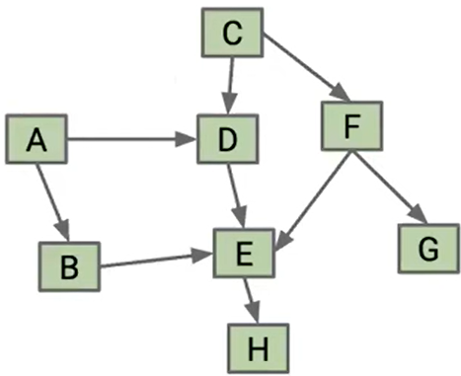
Q. Graph Traversal (Directed Graph)
Give the BFS, DFS pre-order and post-order traversals, topological sort of this directed graph, starting from either A or C. When there are muliple possible orders of visiting the next node, select the next node in alphabetical order.
8
Notes:
Pre-order traversal is (A, B, E, H, D, C, F, G)
Post-order traversal is (H, E, B, D, A, G, F, C)
Topological Sort is (C, F, G, A, D, B, E, H)
Pre-order traversal is (C, D, E, H, F, G, A, B)
Post-order traversal is (H, E, D, G, F, C, B, A)
Topological Sort is (A, B, C, F, G, D, E, H)

Slide 9
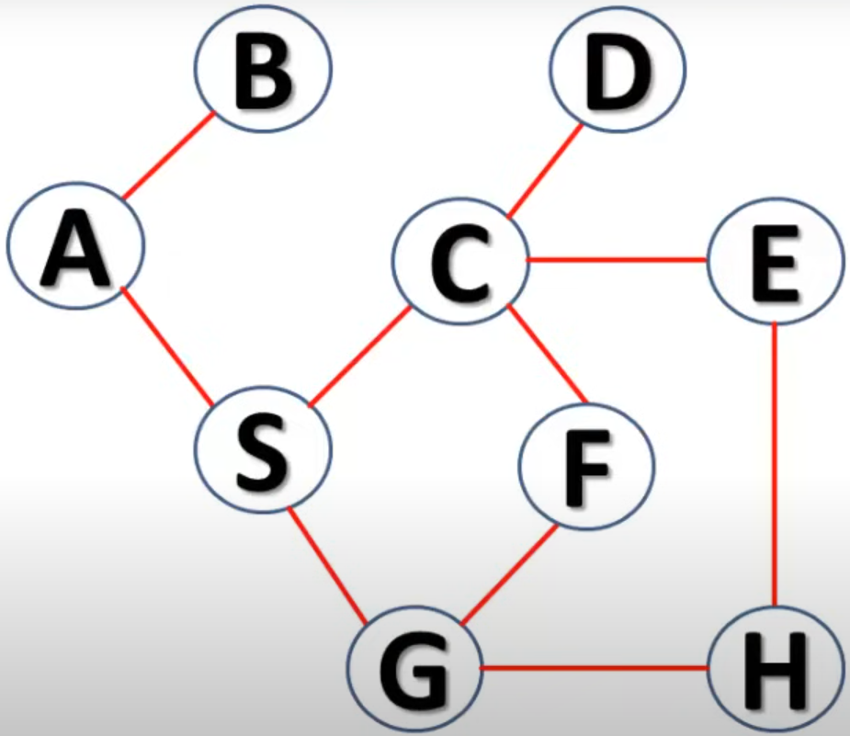
Q. Graph Traversal (Undirected Graph)
Give the BFS, DFS pre-order and post-order traversals of this undirected graph, starting from either A. When there are muliple possible orders of visiting the next node, select the next node in alphabetical order.

Slide 10
Q. Graph Traversal (Undirected Graph)
Give the BFS, DFS pre-order and post-order traversals of this undirected graph, starting from A. When there are muliple possible orders of visiting the next node, select the next node in alphabetical order.
B
F
A
C
E
D
H
G
Notes:
The text in the image is:
A B S C D E H G F
Add to follow-up
Check sources
Citations:
https://pplx-res.cloudinary.com/image/upload/v1744761514/user_uploads/qreQCTCmGSVFnDV/image.jpg
Answer from Perplexity: pplx.ai/share

